Slide 1
Task 6: Integrate Automated Testing into the Pipeline
Done by Sai Saran

Slide 2
SonarQube
SonarQube is an open-source platform that is used to inspect code quality continuously. It performs automated code reviews by scanning the code for possible issues like bugs, vulnerabilities, bad code practices, security risks. and way more. SonarQube supports a vast number of programming languages and plugs into CI/CD pipelines with the help of which the quality of the code is continuously checked, and necessary actions are done to improve it.

Slide 3
Some Key Features In SonarQube
Static Code Analysis
Code Quality Metrics
Security Vulnerabilities
Language Support
Integration with CI/CD Tools

Slide 4
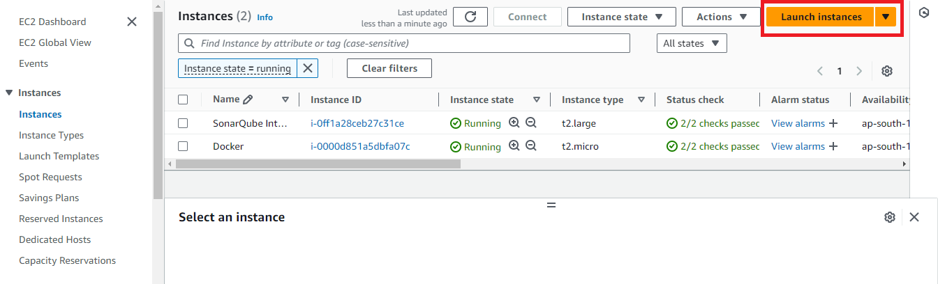
SonarQube Jenkins Integration
Step-1:
First Need to Create one EC2 instance in AWS Console
First click on launch instance in EC2 dashboard

Slide 5
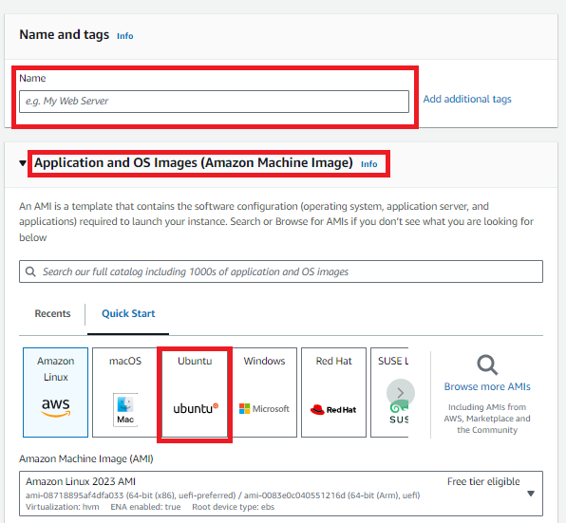
2.After click on the Launch Instance Need to provide Name and select AMI (like Linux, Ubuntu etc.…,)

Slide 6
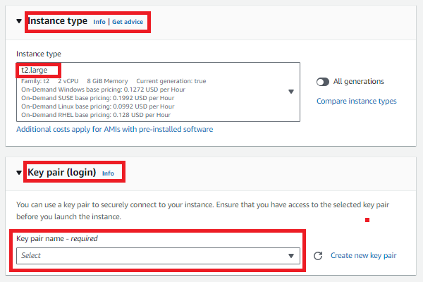
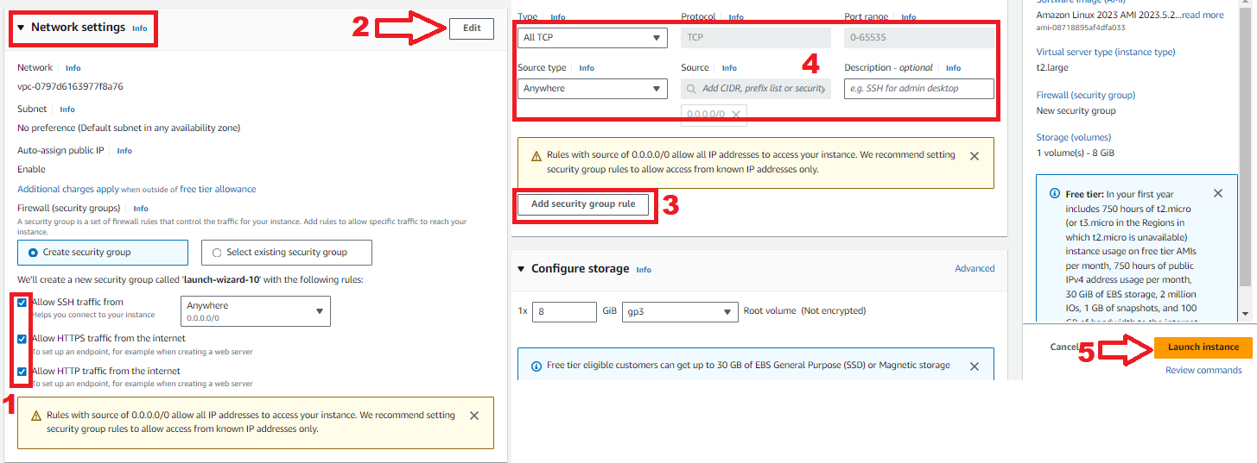
3.Then select Instance Type as t2.large and select select any existing key pair or create new key by click create new key pair.
4.Then go the Network settings and then Allow the HTTP & HTTPS then click on Edit then add security group with All TCP then click on Launch Instance.

Slide 7
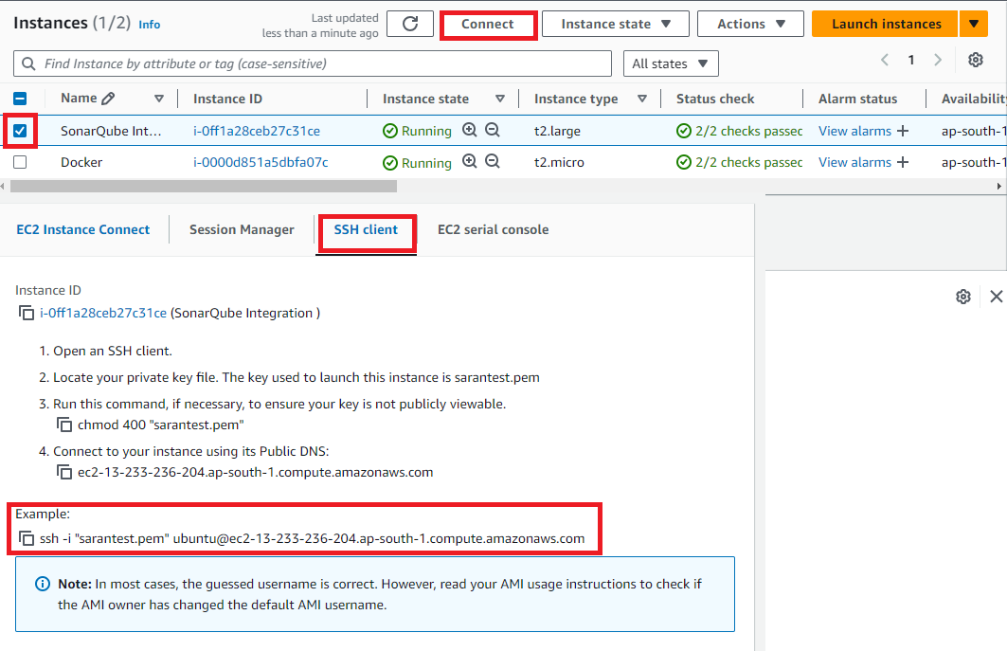
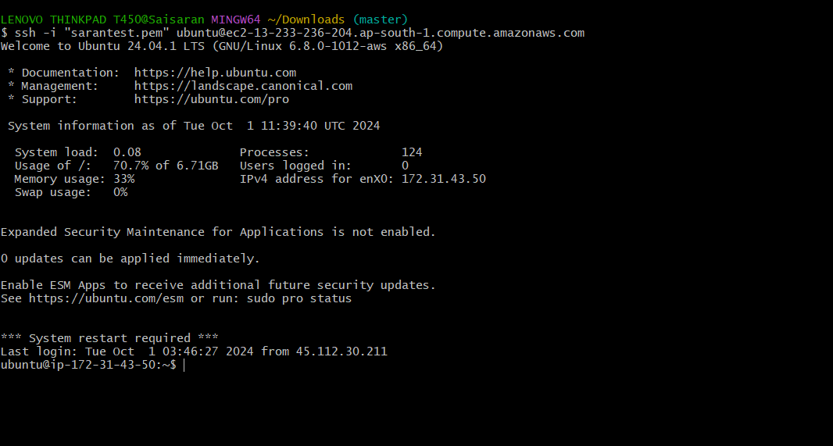
5.After the Instance Created then Connect the instance with any tool(GIT,Mobaxterm etc..,) with SSH Key
6.After Copy the SSH link paste that in any tool (GIT,Mobaxterm etc..,) to connect with AWS.

Slide 8
Jenkins
Jenkins is an open source automation tool written in java-programming language that allows continous integration.
Jenkins will build and test the code.It supports continuous integration (CI) and continuous delivery (CD) pipelines, allowing teams to quickly integrate changes into a project and automate the deployment process.

Slide 9

Step-2:
Now install Java,Maven,Jenkins,sonarqube and Docker in the instance for Integration.
To Install Jenkins follow below commands
sudo apt update -y
sudo apt upgrade -y
wget -O - https://packages.adoptium.net/artifactory/api/gpg/key/public | tee /etc/apt/keyrings/adoptium.asc
echo "deb [signed-by=/etc/apt/keyrings/adoptium.asc] https://packages.adoptium.net/artifactory/deb $(awk -F= '/^VERSION_CODENAME/{print$2}' /etc/os-release) main" | tee /etc/apt/sources.list.d/adoptium.list
Sudo apt update -y
Now need to Install Jdk in Instance for that use sudo apt install temurin-17-jdk -y
After Installing jdk check jdk version by using java –version
Then need to Install Maven In the Instance using
sudo apt install maven -y
Then need to Install Jenkins before install need to add Keys for Jenkins

Slide 10
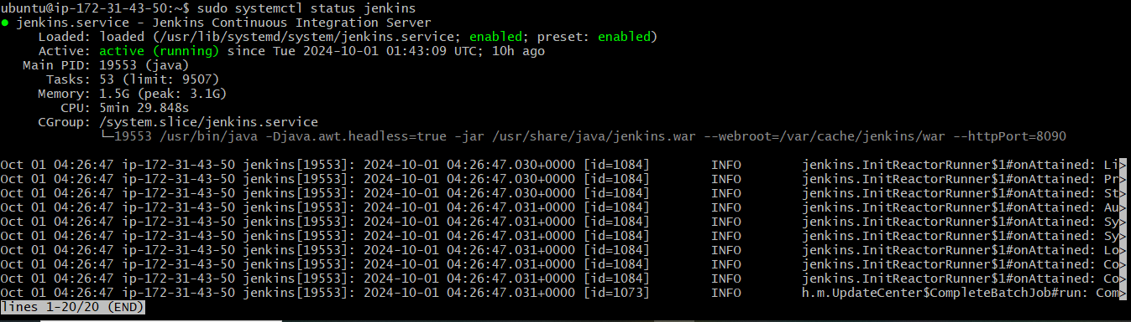
After Adding the keys need to install the Jenkins by using sudo apt-get install jenkins -y
After Jenkins Installed need to Jenkins Jenkins version
Then start the jenkins by using sudo systemctl start jenkins
After starting the Jenkins need to checkstatus of Jnekins it is active or not by using sudo systemctl status Jenkins

Slide 11
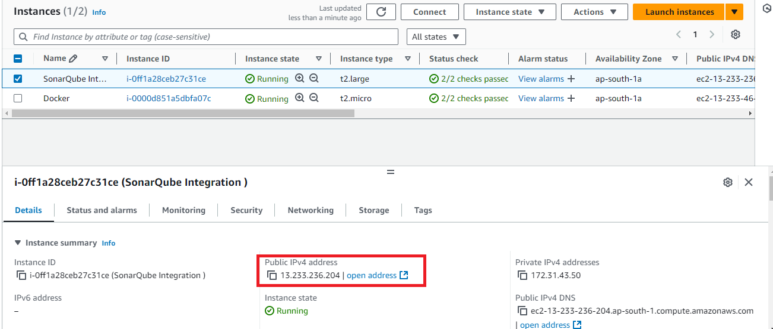
Then connect to the Jenkins dashboard by using Instance public IPV4 address:8080
Once Jenkins is installed and connected to dashboard then for this Application case, we are running Jenkins on another port. so change the port to 8090
For changing to 8090 port first need to stop Jenkins by using Sudo systemctl stop jenkins
Then check the status of jenkins it is inactive or not by using sudo systemctl status jenkins
Now we need to change the port to 8090 for that need to change the directory by using cd /etc/default
After changing into directory need to go vi editor to change the port number by using sudo vi jenkins

Slide 12
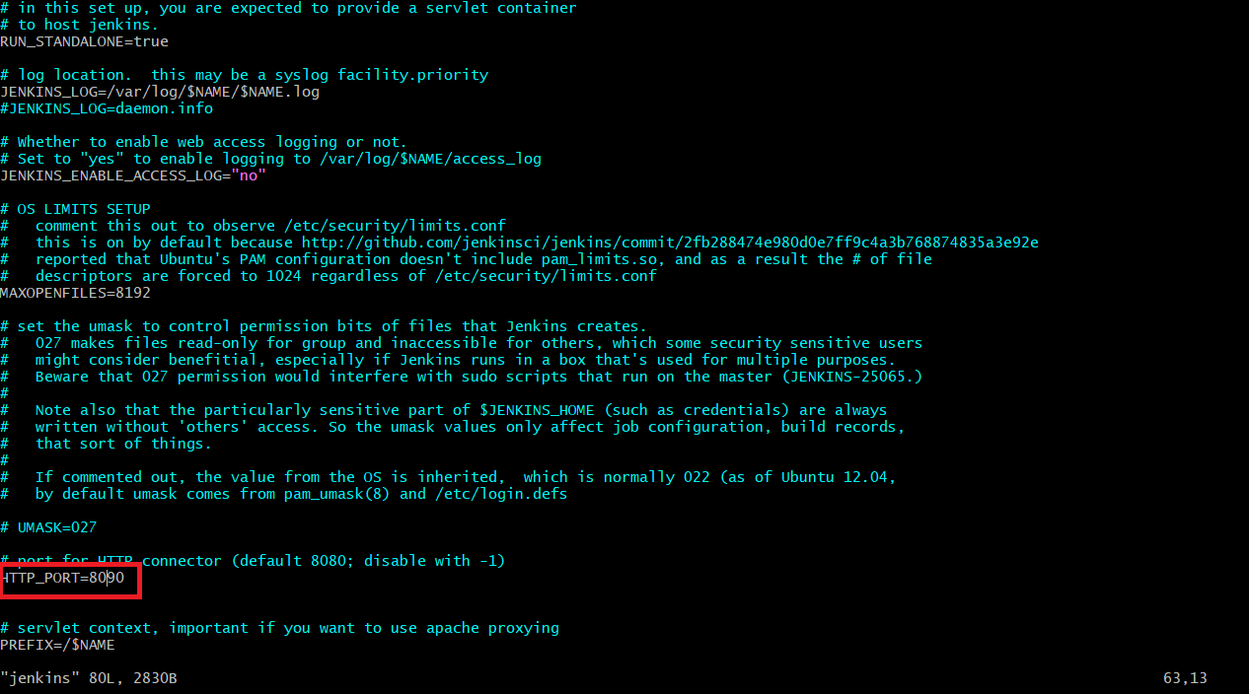

Slide 13
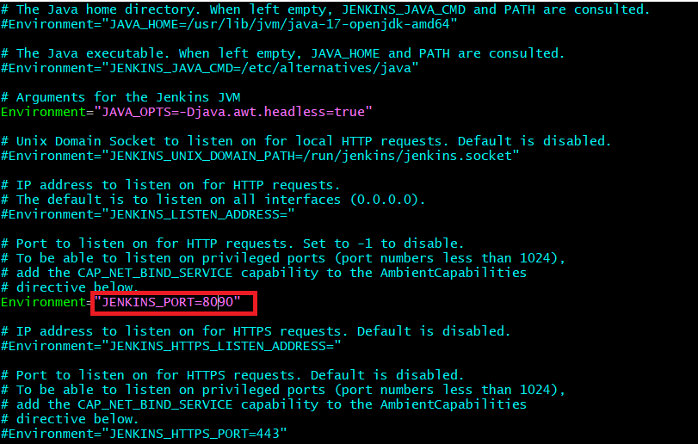
To exit form vi editor need to enter :wq
After exit from vi editor need to change to another directory by using cd /lib/systemd/system
After changing into above directory need to got vi editor again by using sudo vi jenkins.service in this need to change the jenkins port to 8090 and then exit form vi editor

Slide 14
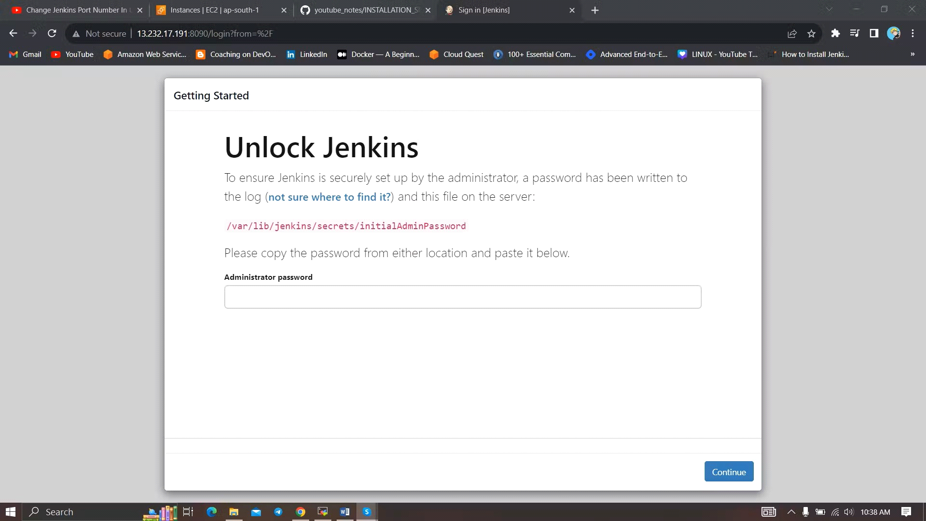
After exit from vi editor need to reload the jenkins server by using sudo systemctl daemon-reload
Step-3:
Jenkins dashboard creation
Then restart the jenkins server by using sudo systemctl restart jenkins
After restarting the service then connect the with 8090 port
Now Unlock Jenkins using an administrative password
To get need to copy var path and paste in Git by using sudo cat var path to get administrative password

Slide 15
Step-4:
1.Need to Install Docker Instance and connect to the sonarQube with Docker Container by using below commands
2.sudo apt-get update
3.After update the tools need install Docker by using sudo apt-get install docker.io -y
4.After Installing the docker create user in usermod by using sudo usermod -aG docker $USER #my case is ubuntu
5.Then New group for docker by using newgrp docker
6.After the docker installation, we create a sonarqube container by using docker run -d --name sonar -p 9000:9000 sonarqube:lts-community Then connect the SonarQube by using Instance public IPV4address:9000 (SonarQube default port number)
Then login with login
Enter username as admin
Enter password as admin
Then click on login

Slide 16
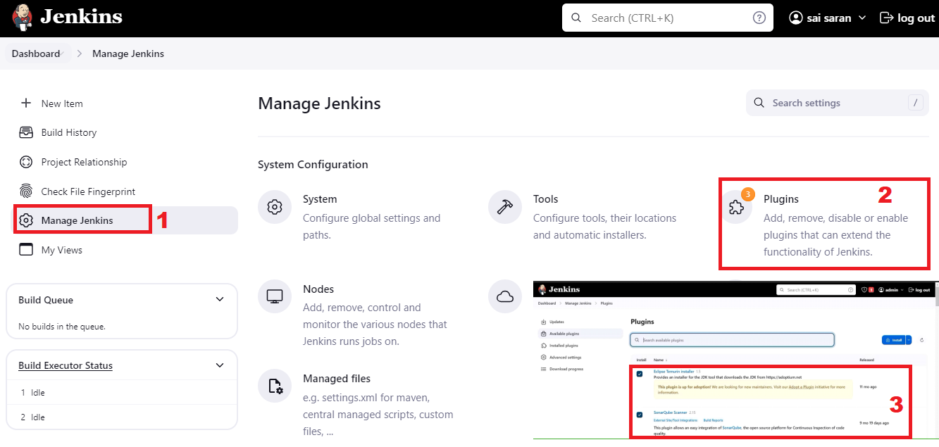
Step-5:
After completing of SonarQube connectivity need to go to the jenkins dashboard and start build the project
Step-6:
First login into Jenkins dashboard and the go to the manage Jenkins and select plugins in plugins need to select available plugins and install the required plugins
1.Eclipse Temurin Installer (Install without restart)
2.SonarQube Scanner (Install without restart)

Slide 17
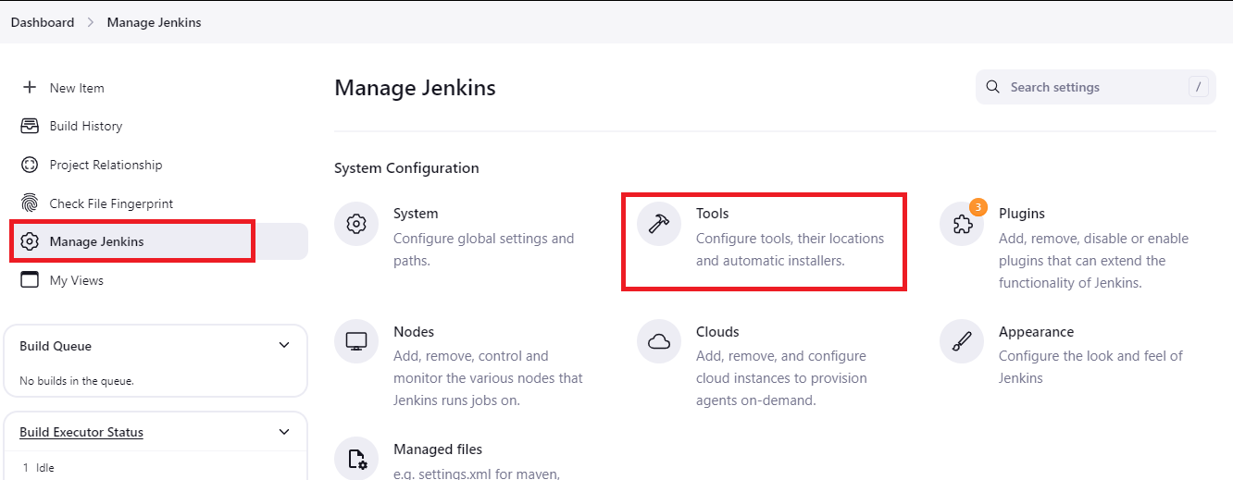
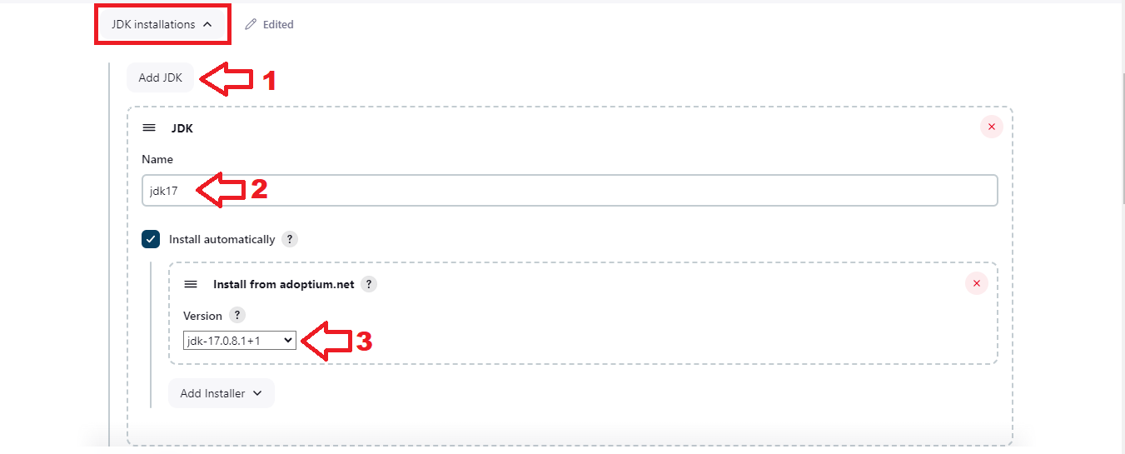
Step-9:
Then again go to the Manage Jenkins and select Tools.
In Tools need to add jdk installation and maven installation
Add jenkins Installation
Name
Java Version (jdk-17.0.8.1+1)

Slide 18
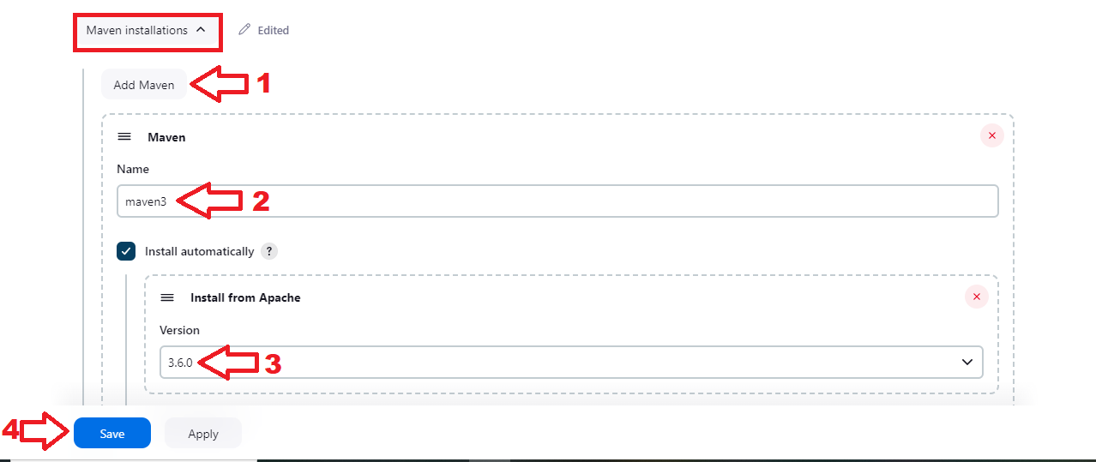
Then again In Tools need to add maven installation and maven installation
Add maven
Name
Maven Version (3.6.0)
Then Apply and Save

Slide 19
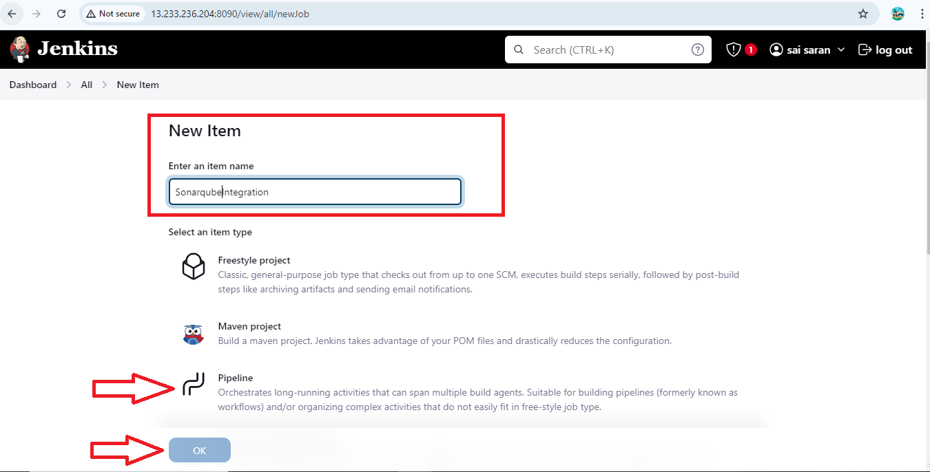
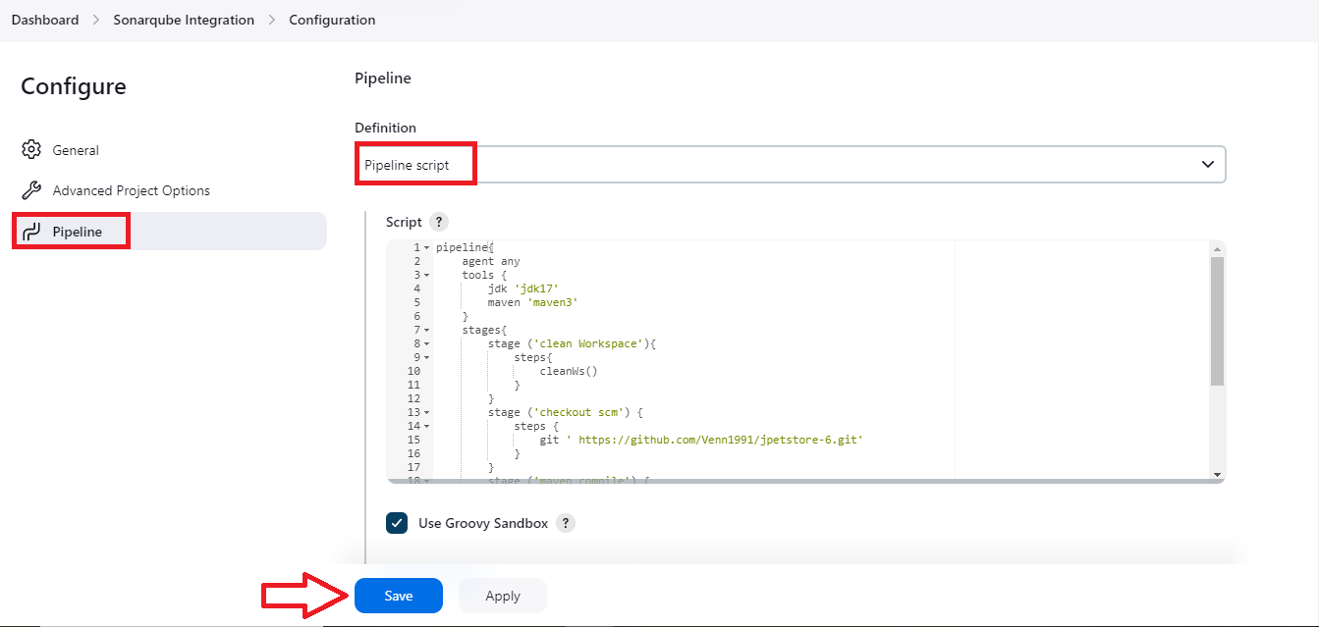
Step-10:
After providing all the information need to Create a new project with Pipeline
Step-11:
After Click on Ok the configure page will open
Then go the Pipeline in Configure and then provide the pipeline script Then Apply and Save.

Slide 20
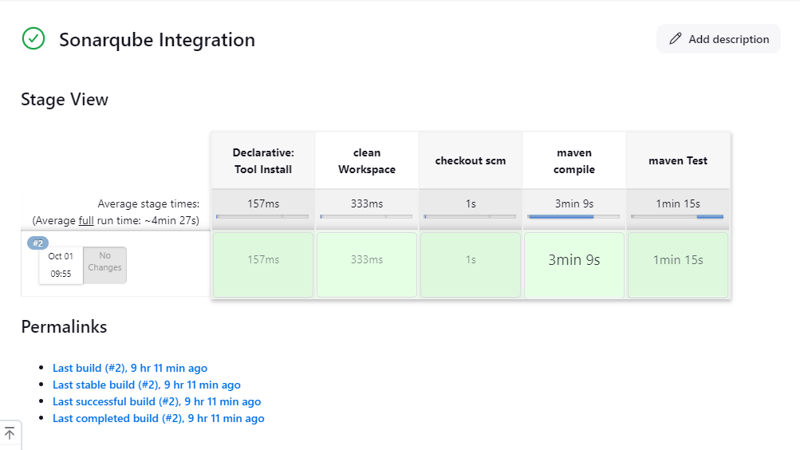
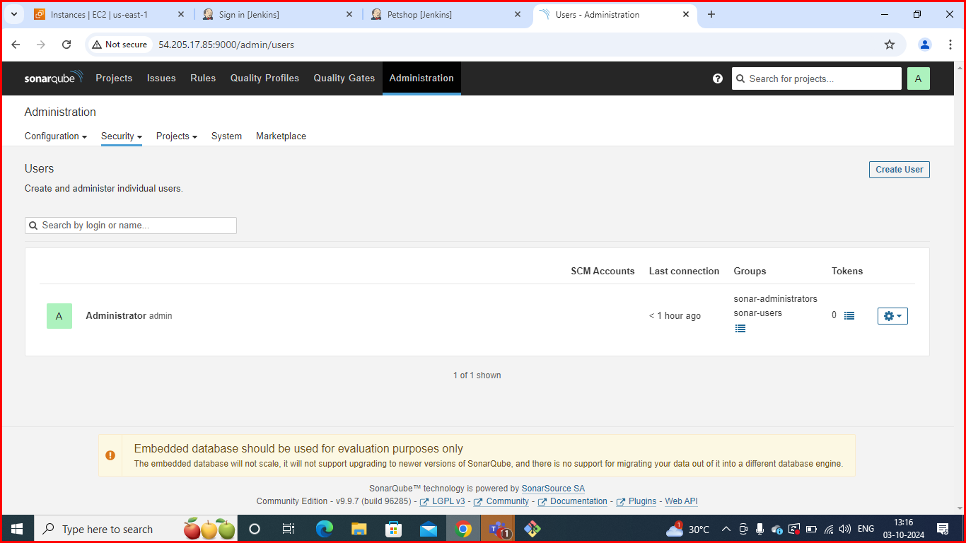
After save the configure page then click on Build Now.
After Click on Build Now you will get success output.
Configure Sonar Server in Manage Jenkins
Create a token with a name and generate:

Slide 21
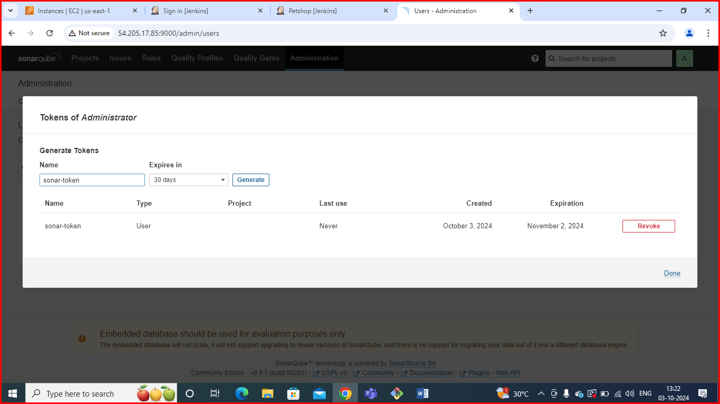
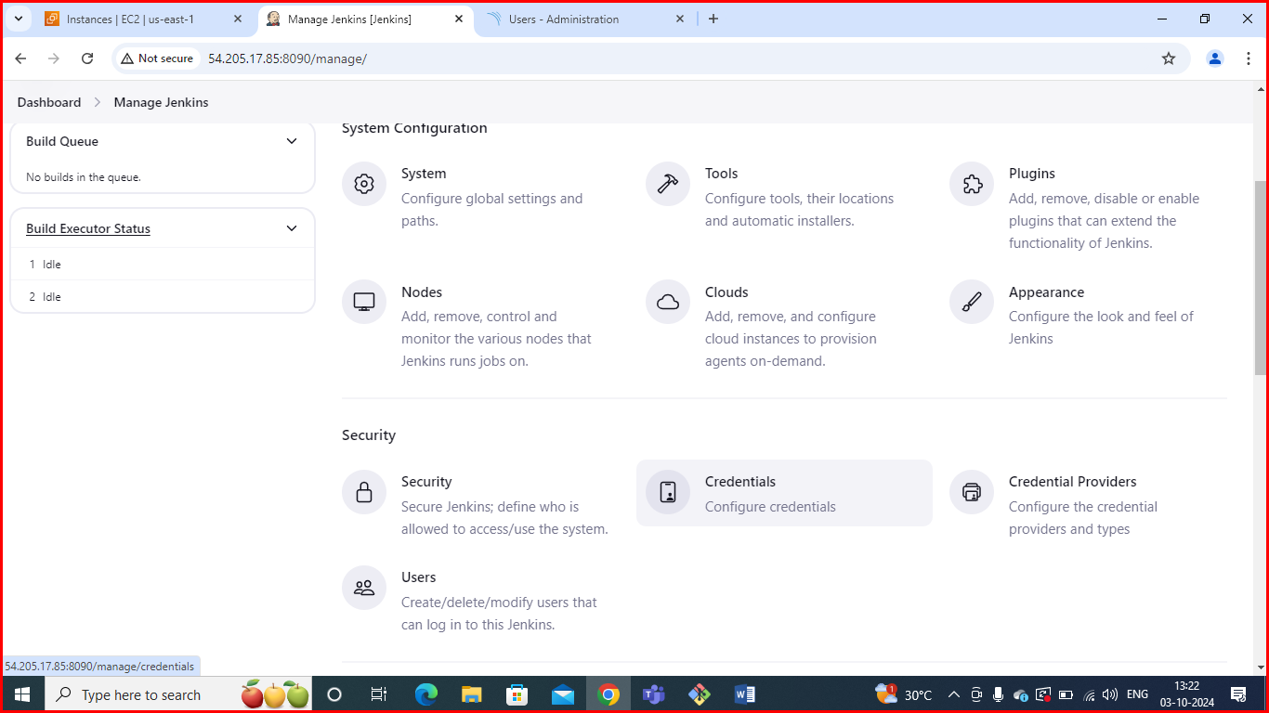
Copy token:
Go to Jenkins Dashboard → Manage Jenkins → Credentials

Slide 22
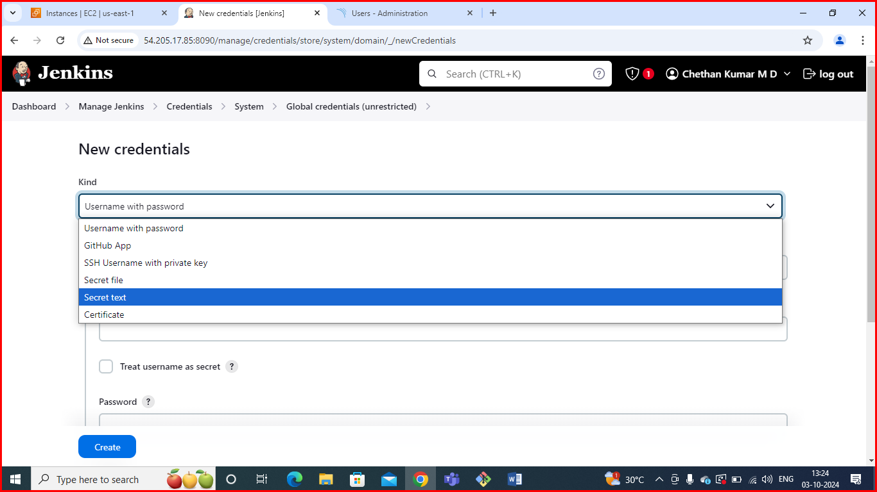
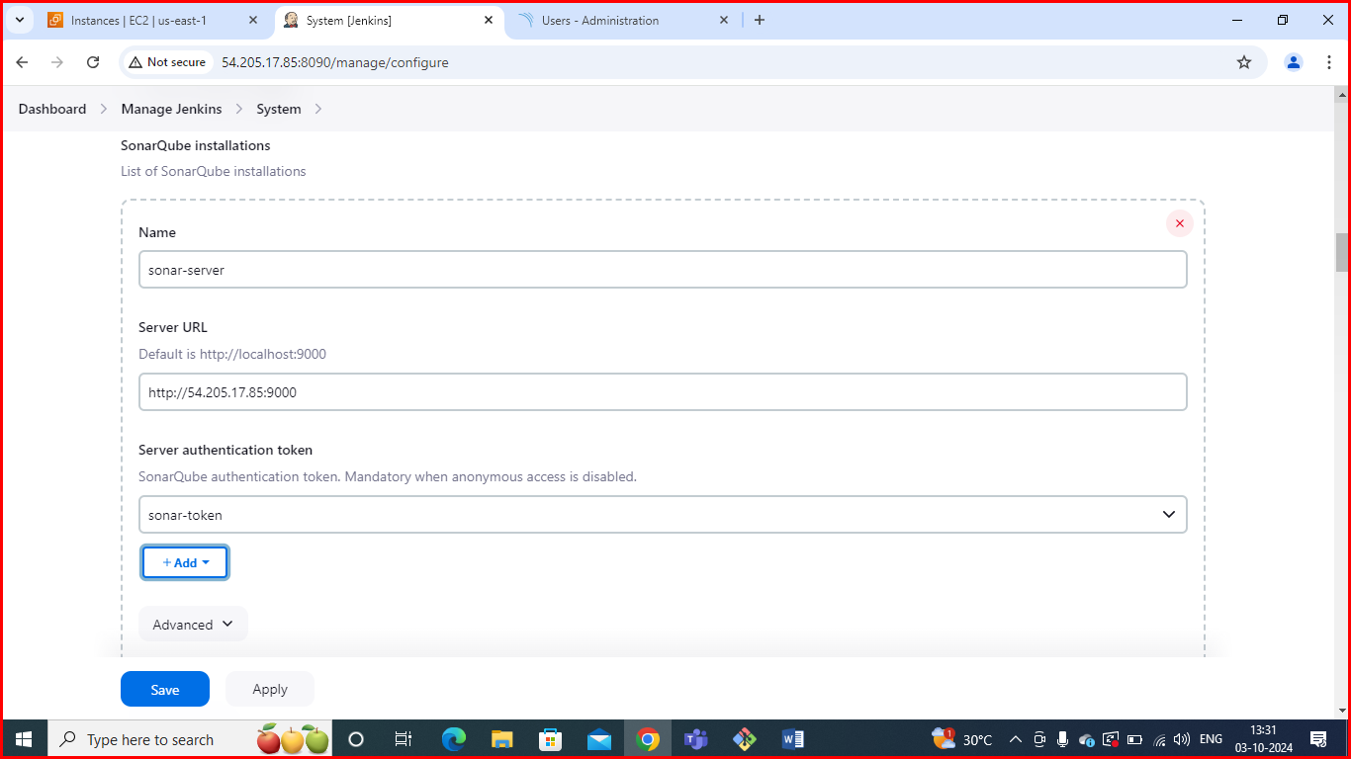
In credentials click on global
Add Secret Text
Now, go to Dashboard → Manage Jenkins → System
Here give name and paste url of sonarQube

Slide 23
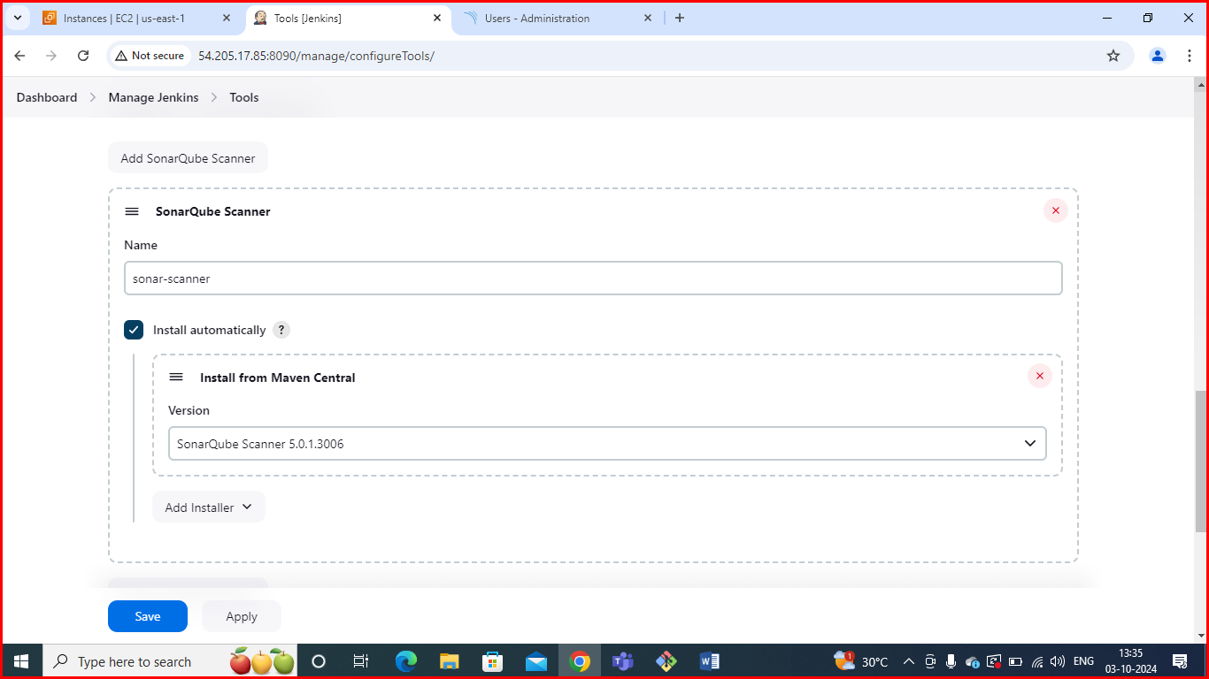
The Configure System option is used in Jenkins to configure different server
Global Tool Configuration is used to configure different tools that we install using Plugins
We will install a sonar scanner in the tools.
In the Sonarqube Dashboard add a quality gate also

Slide 24
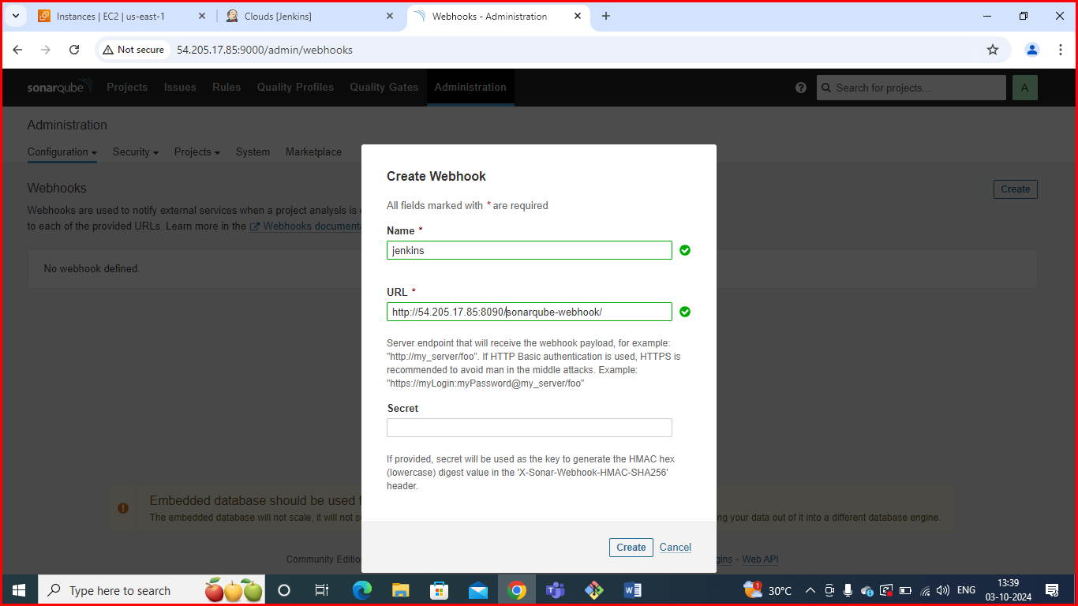
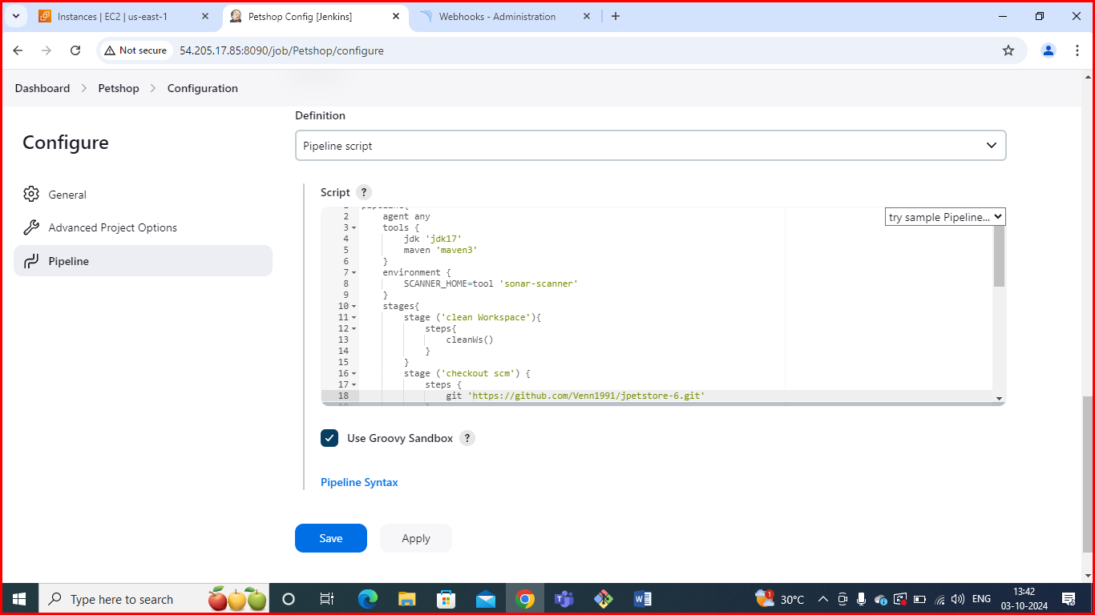
Administration--> Configuration-->Webhooks
Pipeline script: In Jenkins, a pipeline script is used to define the steps and processes for continuous integration and continuous delivery (CI/CD).

Slide 25
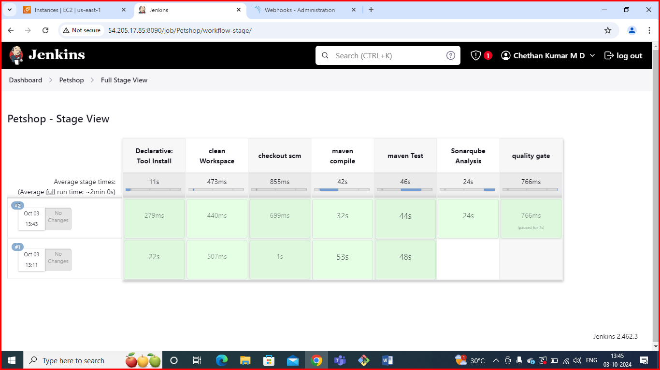
Stage view: The Jenkins Stage View provides a visual representation of the stages of a pipeline job. It helps you monitor the execution flow, see which stages have
completed, and identify any failures in a more user-friendly way than raw console output.

Slide 26
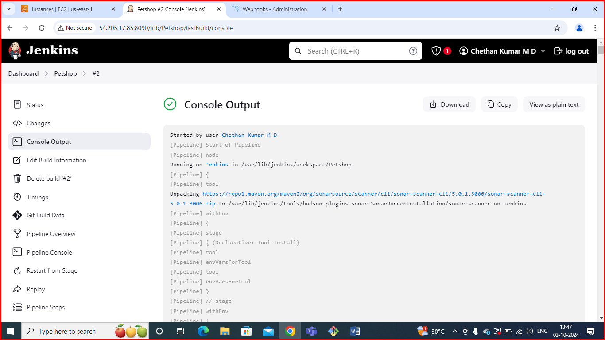
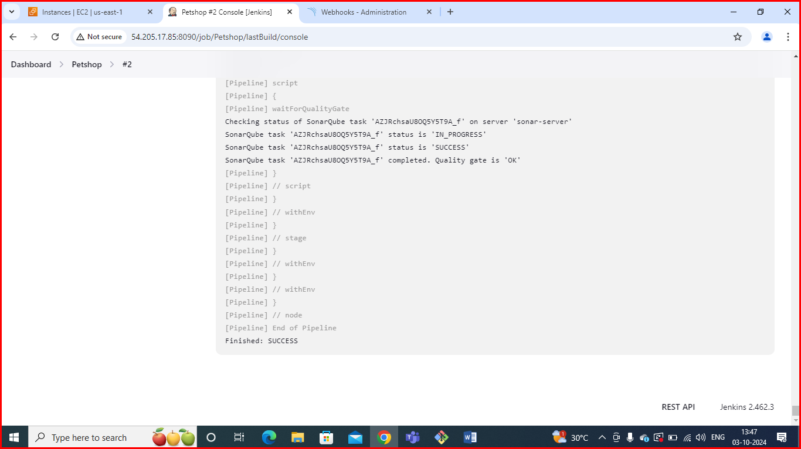
Console output: Jenkins console output provides a real-time view of the build process for a job. It includes logs from each step of the build, allowing you to monitor progress, see error messages, and debug issues.

Slide 27
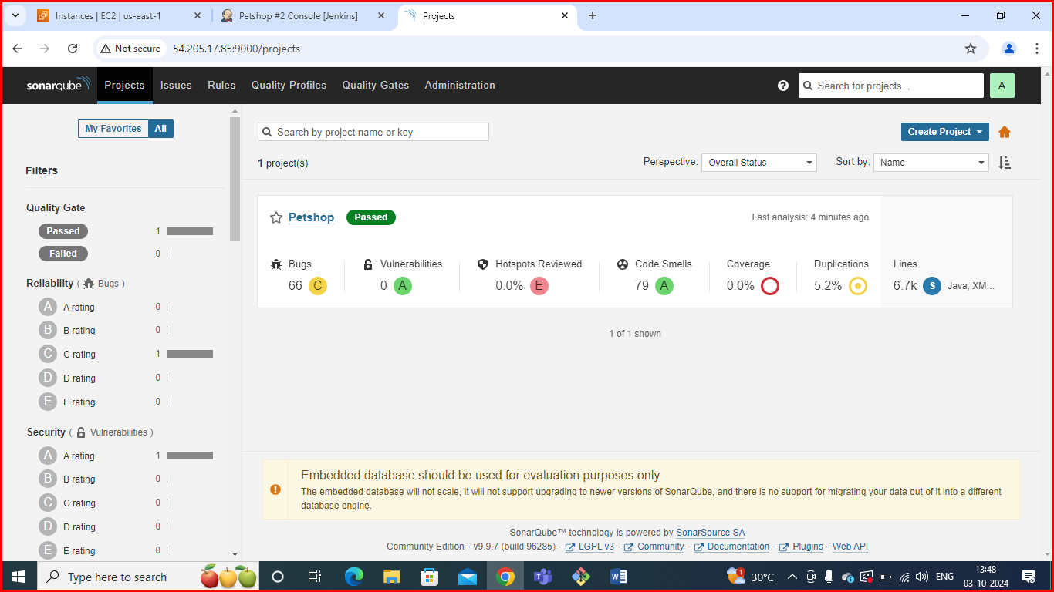
To see the report, you can go to Sonarqube Server and go to Projects.
You can see the report has been generated and the status shows as passed. You can see that there are 6.7k lines. To see a detailed report, you can go to issues.

Slide 28
Conclusion
Adding automated testing to your pipeline helps catch bugs early, saves time, and makes your software more reliable. It reduces the need for manual testing and speeds up the release process.By testing different parts of your code automatically, you can find issues before they become big problems. This leads to better teamwork, faster updates, and smoother deployments.

Slide 29


